Slide 1

What is PnP and Basic operations

Slide 2
What is SharePoint Patterns and Practices?

Slide 3
SharePoint PnP = SharePoint Dev Community

Slide 4

Why wasting time on figuring things by yourself?
What if there would be starting point and assistance to get started?

Slide 5


Reusable open-source components and solutions built together with the engineering

Slide 6

2013
Internal
Internal initiative in Microsoft to start collecting learnings from add-in model
2014
Going public
Going first public in CodePlex, then moved to GitHub. Concentration on add-in model enterprise scenarios.
2015
Reusability
PnP Provisioning Engine introduced. Reusable components and solutions. Weekly webcasts started.
2016
Partnership
PnP ownership moved to engineering, team works with a partnership on aligning roadmap. Work with SP Framework starts.
2017
Integration
SharePoint Dev Ecosystem = SharePoint PnP. End-to-end coordination of the SharePoint development guidance and engagement
2018
Solutions
From reusable components alignment to reusable solutions. Concentration on modern transformation and experiences
More than 450 samples to learn and take advantage in your work
More than 1.9 million watch time minutes in SP Dev YouTube channel in past 365 days
More than 840 contributors in GitHub organization.
More than 52000 unique visitors during past 2 weeks in GitHub repositories
More than 50000 tenants have used open-source PnP components and controls in SharePoint Online.

Slide 7
Learn
Reuse
Share
aka.ms/sppnp

Slide 8
Learn

Slide 9
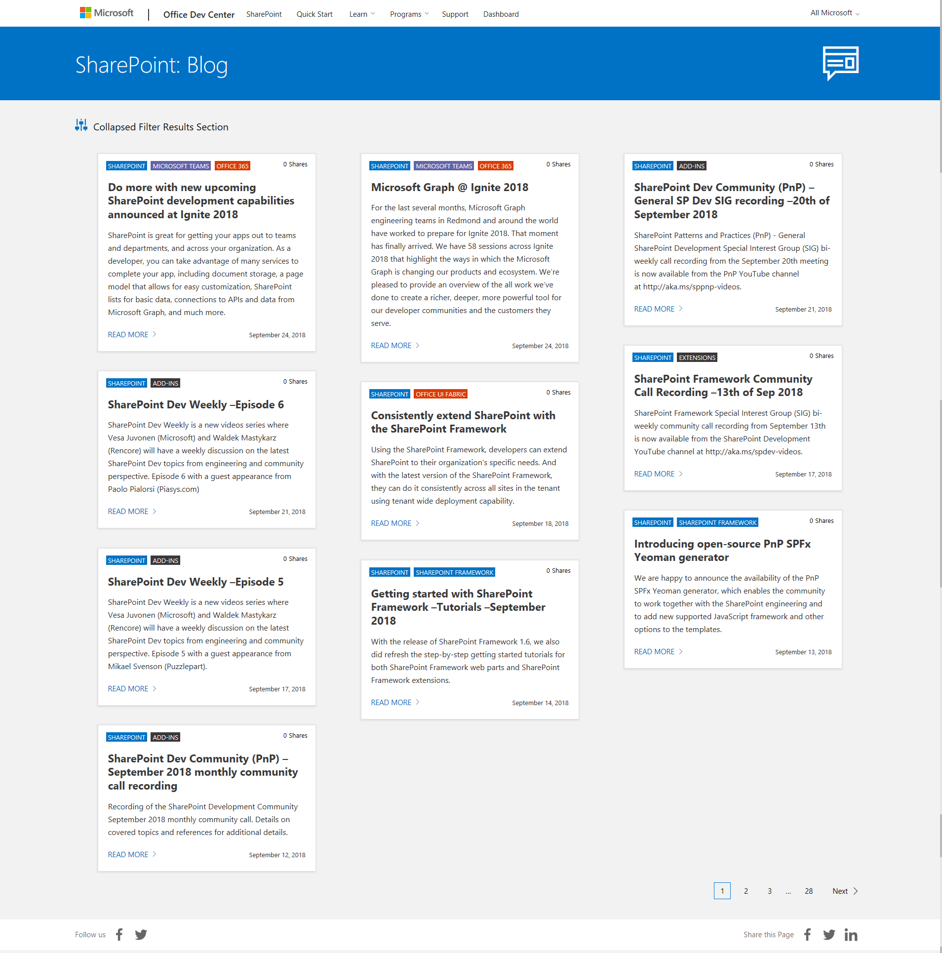
SharePoint Dev Blog aka.ms/spdev-blog
Announcements
News
Releases
Community call recordings

Slide 10
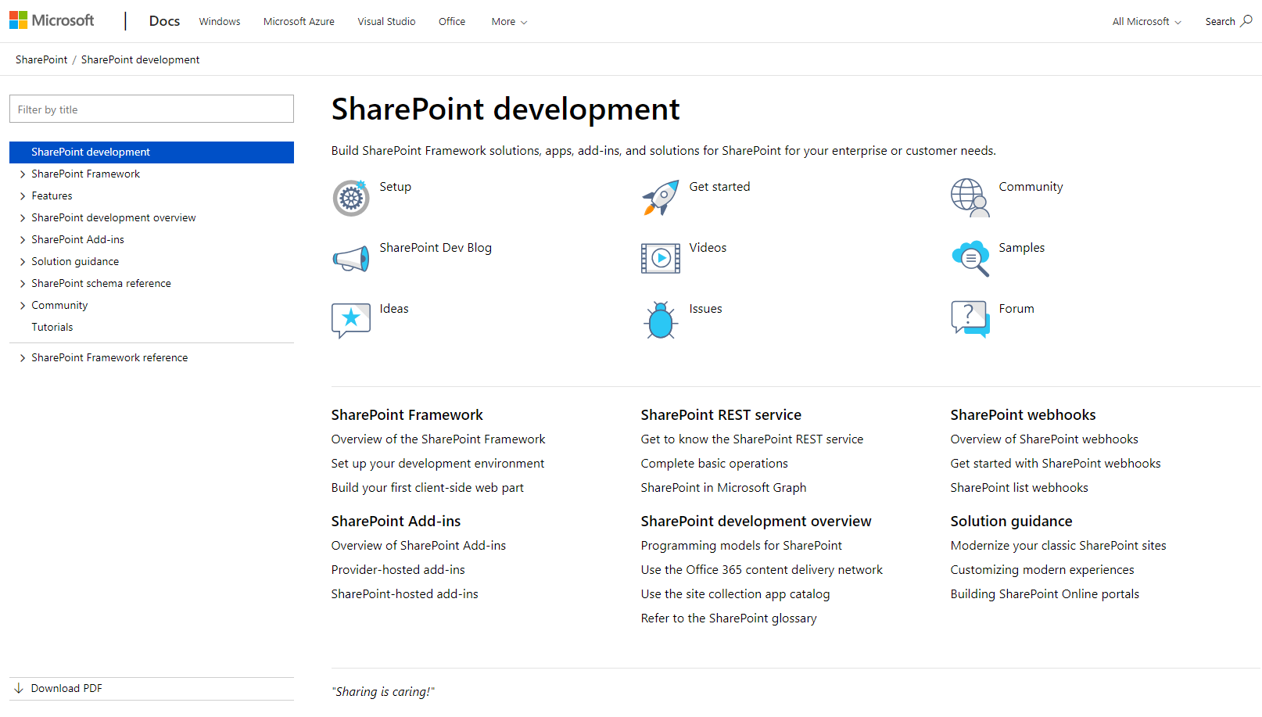
Documentation and guidance aka.ms/spdev-docs
Consolidated location for documentation and guidance
SharePoint Framework, including API reference
SharePoint add-ins
Declarative customizations
etc.

Slide 11
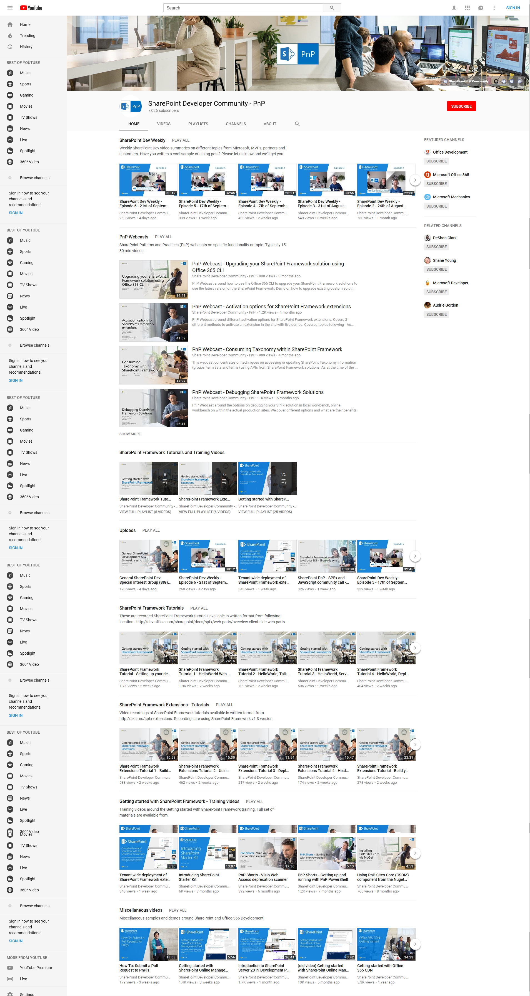

Videos and webcasts aka.ms/spdev-videos
Web cast recordings
Quick Guidance Videos
Tutorial Videos
Training Videos
Weekly and monthly community call recordings
>350 videos already

Slide 12
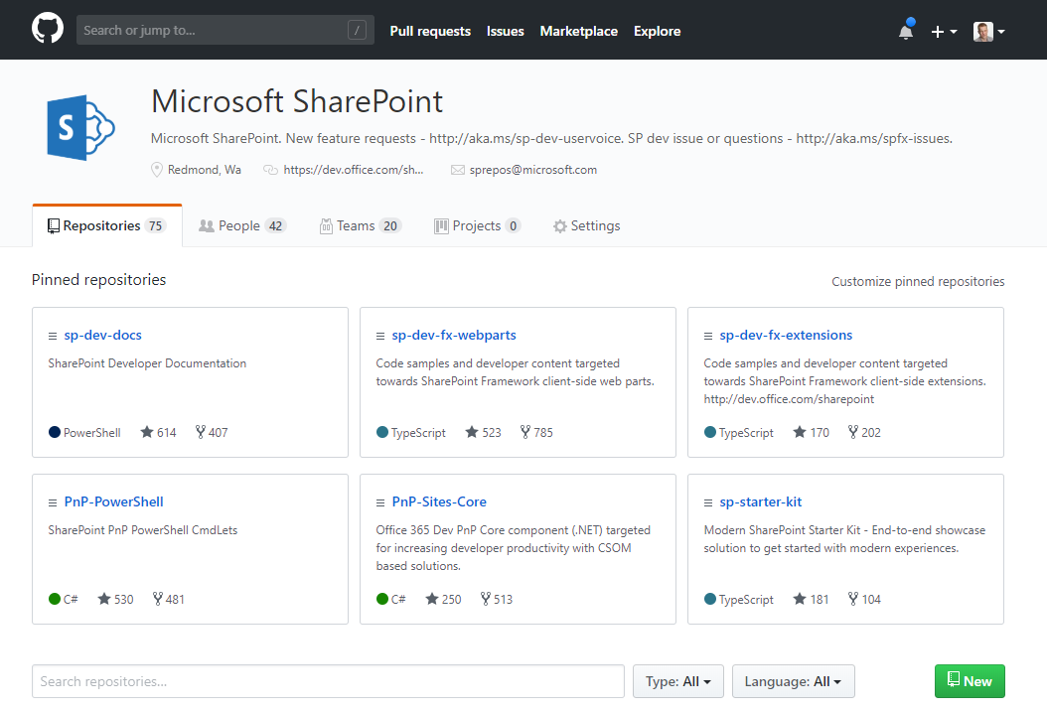
Samples and solutions
github.com/sharepoint
SharePoint Framework
Provider hosted Add-ins
Reusable controls and components
PnP PowerShell and Scripts
Build extensions
>450 samples

Slide 13
Reuse
aka.ms/sppnp

Slide 14
Build Extensions
PnP PowerShell
PnP Partner Pack
Scanner Framework
Reusable React Controls
GDPR Activity Hub
PnPjs
PnP Provisioning Engine
PnP Remote Provisioning Schema
Modernization Framework
SharePoint Starter Kit
Reusable Property Controls
Extension Samples
Office 365 CLI
VS Studio Extension for SPFx
Web Part Samples
SharePoint Framework Solutions
PnP CSOM
yo @pnp/spfx

Slide 15
Why use PnP core for basic operations?
Repeatability
Code is tested
Follows established patterns
Simplicity
Replace large code blocks with existing PnP methods
Wraps complex functionality in easy to consume methods
Supportability
Support for common and complex actions
Monthly updates to address community reported bugs and include enhancements

Slide 16
Plain CSOM example
using (clientContext)
{
var list = clientContext.Web.Lists.Add(new ListCreationInformation
{
Title = "MyList",
Url = "lists/mylist",
TemplateType = (int) ListTemplateType.GenericList
});
clientContext.Load(list);
clientContext.ExecuteQuery();
}

Slide 17
PnP core web extensions example
using (clientContext)
{
var list = clientContext.Web.CreateList(ListTemplateType.GenericList, "MyList", false);
}

Slide 18
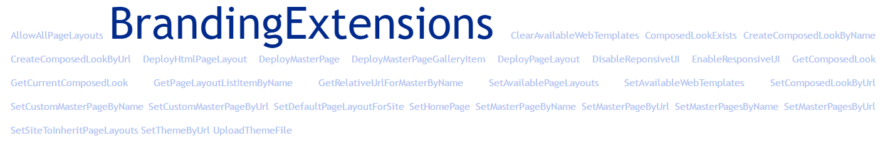

Slide 19
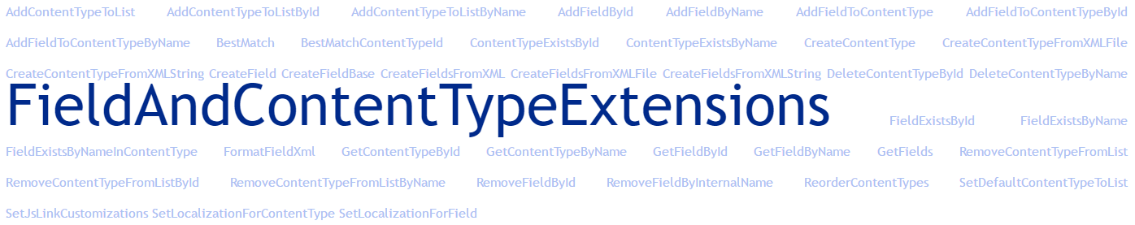
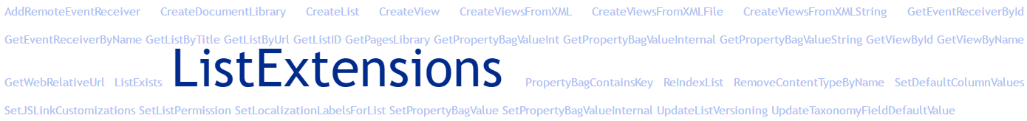

Slide 20

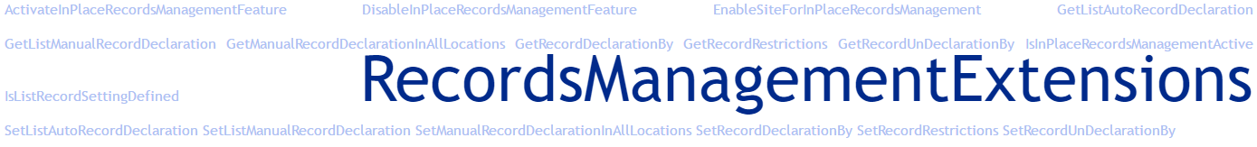
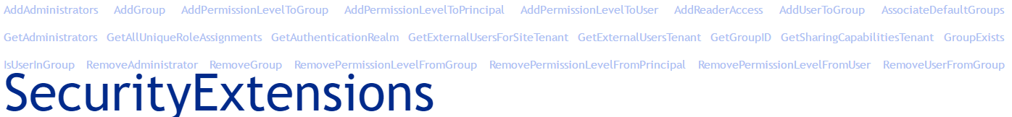

Slide 21
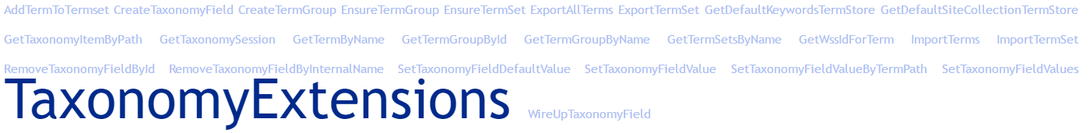
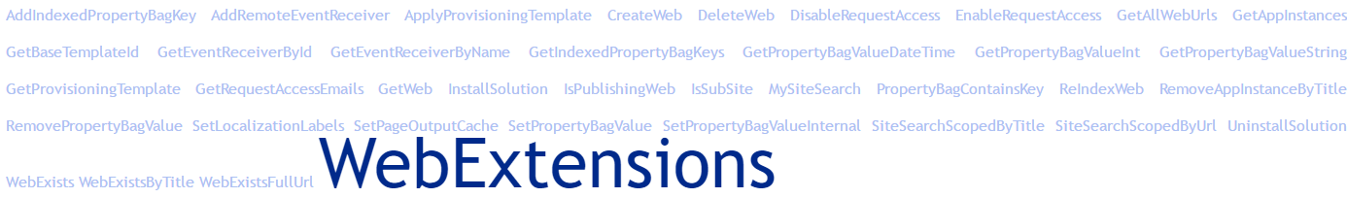

Slide 22
Share
aka.ms/sppnp

Slide 23



How to participate to the PnP initiative?
Participate on the discussion
Help others with your questions and answers
aka.ms/SPPnP-Community
Submit issues
Submit fixes
Contribute with new samples, guidance and documentation
Participate on the discussion around needed capabilities
Microsoft Tech Community
Monthly SharePoint community call
aka.ms/spdev-call
Bi-weekly SharePoint Framework SIG
aka.ms/spdev-spfx-call
Bi-weekly SharePoint General Dev SIG
aka.ms/spdev-sig-call
twitter.com/sharepoint
twitter.com/officedev
twitter.com/officedevpnp
aka.ms/sppnp

Slide 24























Why to contribute?
Get acknowledged as contributor in the communications
SharePoint blog posts
Monthly community calls
docs.microsoft.com
Help others by sharing your learnings around Office 365 and SharePoint development
aka.ms/sppnp

